Slide 1
Full Year Results:
Year Ended 31 March 2022
Chief Executive : Stuart Munro

Slide 2
Trading Overview

Slide 3
Group Highlights
Revenue increased by 24% to £40.3m (2021: £32.6m).
Underlying pre-tax profit of £2.3m (2021: £0.1m) despite government support reducing to £0.5m (2021: £1.8m).
Profit underpinned by net cash flow from operating activities of £5.1m.
Consistent performance in FIC despite second year without tourists.
Much improved trading performances at Momart and Gosport Ferry.
Strong balance sheet with cash of £9.6m in line with prior year after adjusting for repayment of £5m of CBILS loans.
Final dividend of 2.0 pence per share to be proposed at the AGM taking total for the year to 3.0 pence per share.

Slide 4
Split by Business:

Slide 5
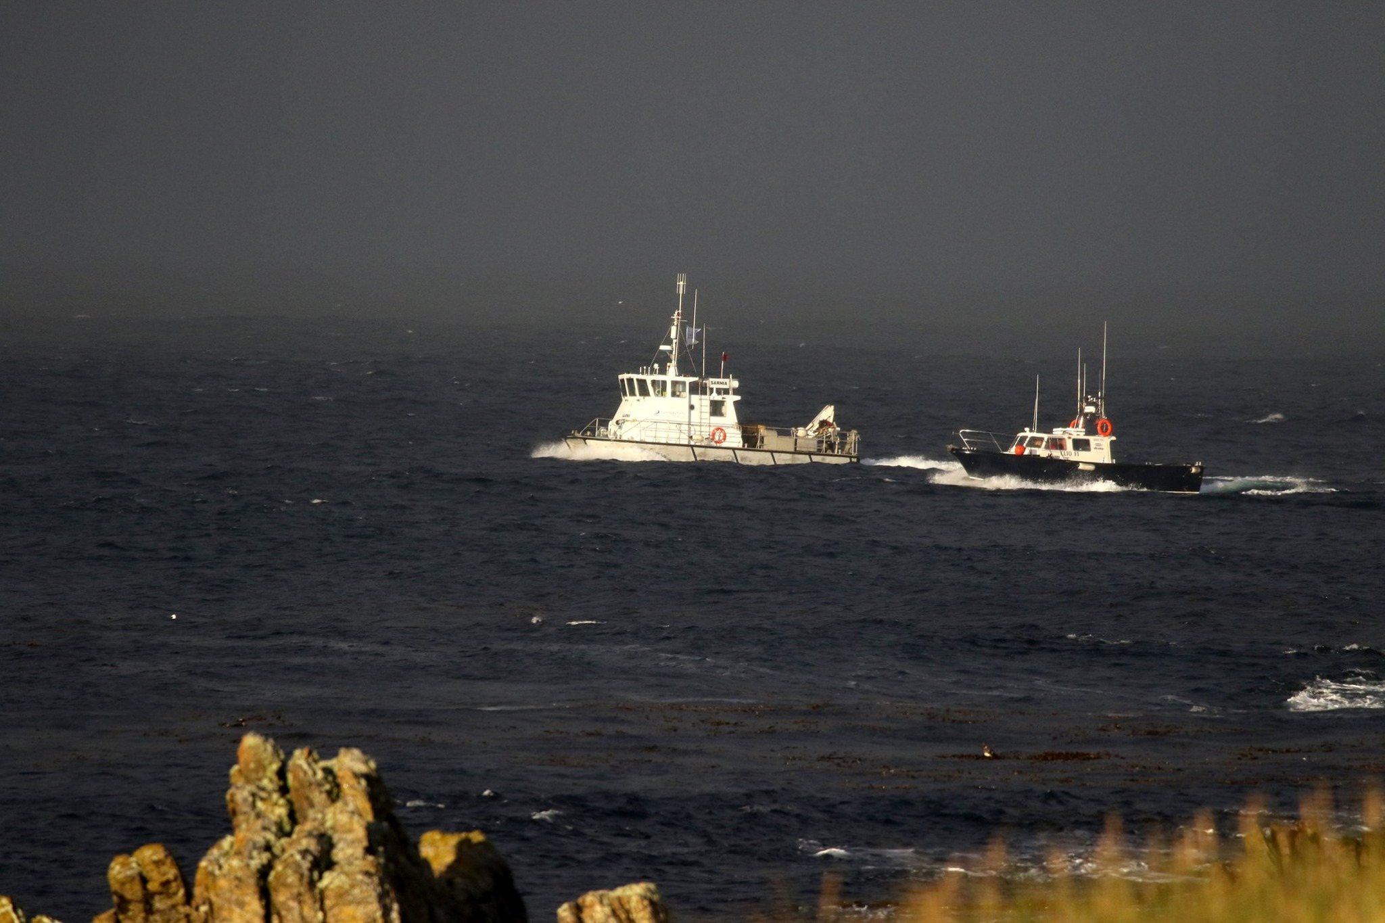
Falkland Islands Company (FIC)

Slide 6
FIC Trading Overview

Slide 7
FIC Trading Overview
Total revenue of £21.6m (2021: £20.9m) up 3.3%.
  FBS revenue up £0.5m driven by road and drainage works for FIG.
  Support Services revenue up £0.2m due mainly to increased shipping agency work following vessels being allowed back into Stanley Harbour.
Retail sales of £9.7m consistent with prior year. Contribution reduced due to a change in sales mix and increased overheads.
Underlying pre-tax profit of £1.8m in line with prior year.
Number of rental properties increased to 83 (2021: 75) but occupancy rate reduced to 86% (2021: 93%) reflecting properties being held for incoming employees and service providers.

Slide 8
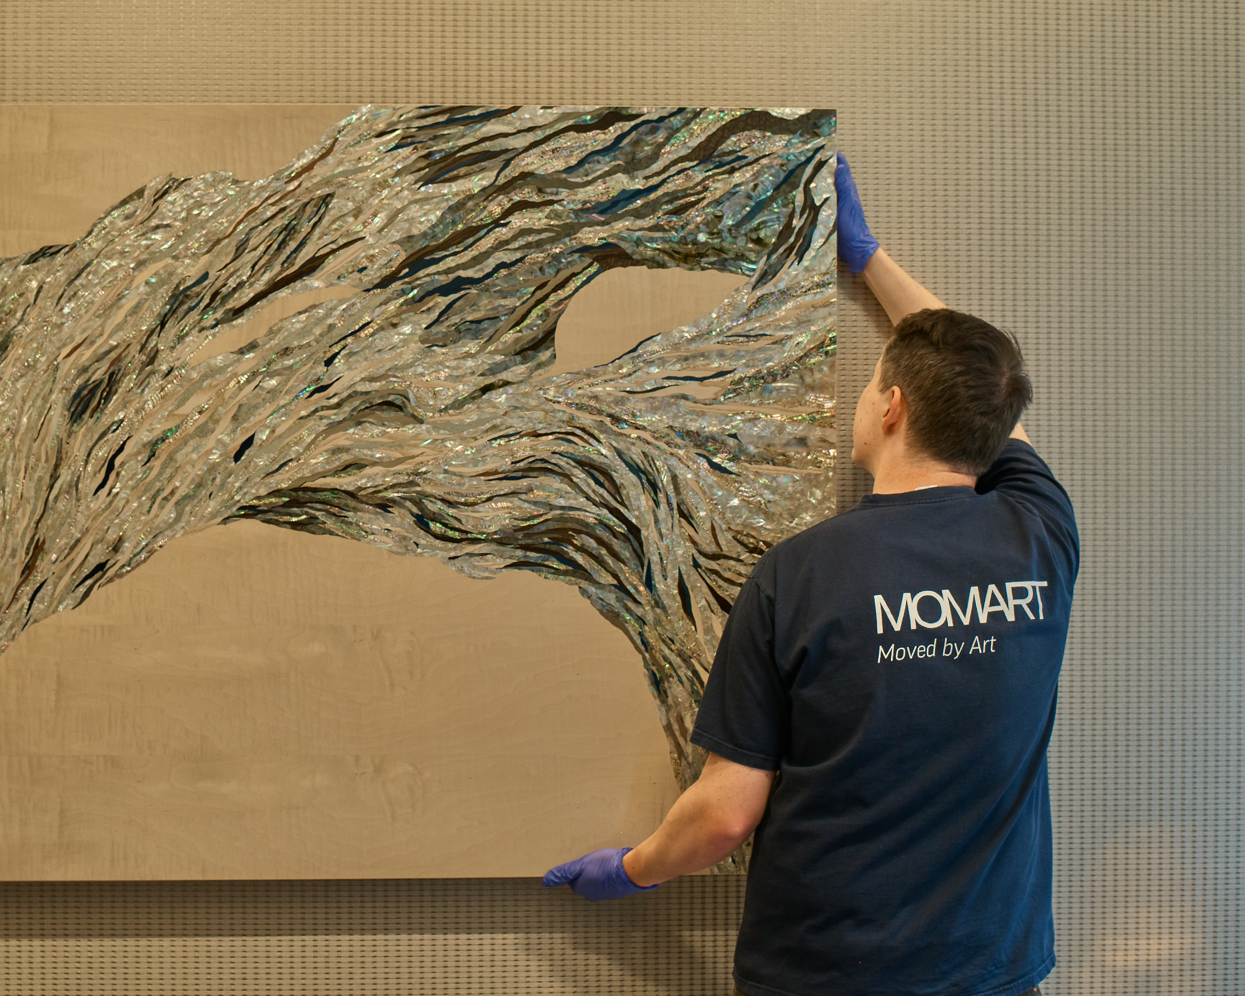
Momart

Slide 9
Momart : Trading Overview

Slide 10
Momart Trading Overview
Revenue of £15.6m increased by 52% on prior year.
  Significant improvements in Museum Exhibitions and Gallery Services.
  Consistent level of storage income and healthy utilisation of space.
Lifting of Covid restrictions improved activity levels by allowing:
  Planning of exhibitions.
  The return of art fairs and release of pent-up demand.
Underlying pre-tax profit of £0.6m versus £0.5m loss in the prior year despite pandemic-related support reducing to £0.4m (2021: £1.4m).
Not yet back to pre-pandemic activity levels but significant progress.
Number of Exhibitions near to pre-pandemic levels but overall expenditure remains supressed.

Slide 11
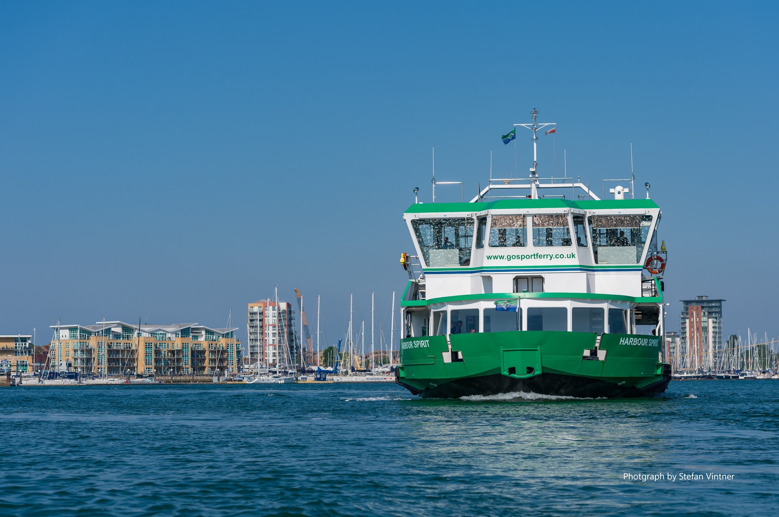
Gosport Ferry

Slide 12
Gosport Ferry : Trading Overview

Slide 13
Gosport Ferry Trading Overview
99.9% service reliability maintained.
Passenger numbers more than doubled to 1.7m.
  Steady growth over the year reaching 80% of pre-pandemic levels over the autumn.
  Dipped in December following Government advice to work from home
  Back to 76% of pre-pandemic levels at year end.
Revenue increased by 121% to £3.1m.
Underlying pre-tax loss of £0.1m (2021 £1.2m loss).
Prices increased in April 2022.

Slide 14
Trading Outlook and Strategy

Slide 15
Trading Outlook
Resilient profits at FIC should benefit from:
  Expected return of tourists to the Falkland Islands.
  Strong order book.
  Potential opportunities for further work for the Falkland Islands Government and the MOD.
Further improvement in activity levels in Momart and Gosport Ferry as the impact of COVID recedes.
Clear strategy in place for delivering increased shareholder value.

Slide 16
Strategy
Build current businesses back to and beyond pre-COVID position.
  Good progress but more to do.
  Focus on control of costs and mitigating the impact of inflation.
Invest in developing existing businesses.
  Capitalise on Government and MOD work and maximise use of land assets in the Falkland Islands.
  Monitor potential opportunities arising from Sea Lion oil field development.
Explore the potential for strategic acquisitions but only if they:
  Can be secured at an appropriate price.
  Add to existing activities of the Group or bring growth potential in other sectors.
  Can be integrated and optimised within management capacity.

Slide 17
Appendices
Cash Flow, Balance Sheet, Net Borrowings & Liquidity

Slide 18
Cash flow - for the year ended 31 March

Slide 19
Balance sheet

Slide 20
Borrowings, Cash & Liquidity

