Slide 1
Falkland Islands Holdings
Interim Results 6 months ended
30 September 2014
Notes:
EPS Target – Average Annual growth in EPS 10% PA for the next 5 years

Slide 2
FKL Interim Results – Sept 2014 - Overview
FIC: Stronger Trading – Profits +£0.24m to £0.54m -Preparation for 2015 drilling campaign & record squid catch.
Momart: Revenues and profits lower as expected – Contribution £0.34m down from record levels seen in 2013-14 at £0.41m.
PHFC: Revenues ahead by 2.6%. PBT + 12% at £0.35m.
Group : Profits down £0.07m ( -4.9% ) to £1.3m - in line with expectations.

Slide 3
FKL : 6 Months ended 30 September 2014
Trading Overview
Revenue up by 5.8% to £18.2m (2013: £17.2m)
  FIC : Strong recovery – economy boosted by record squid catch & confirmation of 2015 drilling programme >profits up £0.24m to £0.54m
  Momart : > Absence of high margin overseas contracts. Revenue down 9% - profits lower by 45% to £0.41m ( 2013: £0.76m ) as expected .
  PHFC : Satisfactory trading – revenue and profits modestly ahead
Group Underlying Operating profit £1.41m (2013: £1.47m) lower by 4.1%
Underlying pre tax profits -4.9% at £1.30m (2013: £1.37m)
Interim EPS on underlying profits 8.0p (2013: 8.1p)
Maintained Interim dividend 4.0p per share payable on 23rd Jan 2015
Cash balances £4.1m (2013: £8.2m)
FOGL holding of 12.8m shares unchanged ( Mkt value £3.6m @ 28p )

Slide 4
FKL : Summary P&L - 6 months ended 30 September 2014
6 months ended 30 September | 2014 £000 | 2013 £000 | Change +/-
Turnover | 18,242 | 17,239 | +5.8%
Operating profit Group share of the Joint Venture profit | 1,334 77 | 1,472 -
Trading Profit | 1,411 | 1,472 | -4.1%
FIC Pension scheme financing costs | (60) | (60)
Pontoon lease interest Net Bank / HP interest received/(paid) | (116) 69 | (117) 76
Net financing costs | (107) | (101)
Underlying Pre Tax Profit (PBTae)** | 1,304 | 1,371 | -4.9%
Amortisation of Intangibles | (72) | (193) | -62.7%
Gain on PHFC pension scheme wind up | - | 64
Profit Before Tax | 1,232 | 1,242 | -0.8%
Diluted EPS (PBTae basis) | 8.0p | 8.1p | -1.2%
*
**PBTae – profit before taxation , amortisation and non trading items

Slide 5
FKL : Segmental Analysis - 6 months ended 30 September 2014
6 Months ended 30 September | 2014 £000 |  | 2013 £000 | Change +/-
Turnover
FIC | 8,478 |  | 6,757 | +25.5%
PHFC | 2,295 |  | 2,236 | +2.6%
Momart | 7,469 |  | 8,246 | -9.4%
Total Turnover | 18,242 |  | 17,239 | +5.8%
Pre Tax Profit
FIC | 538 |  | 301 | +78.7%
PHFC | 349 |  | 311 | +12.2%
Momart | 417 |  | 759 | -45.1%
Underlying Pre-Tax Profit (PBTa) | 1,304 |  | 1,371 | -4.9%

Slide 6
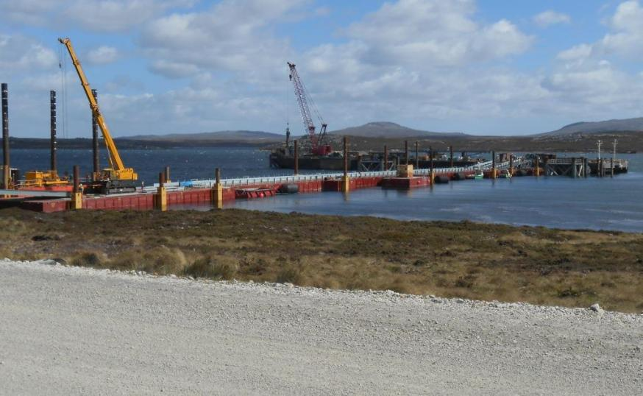
FIC : Preparing for Offshore Oil Exploration

Slide 7
FIC – Year ended 31 March 2012
FIC : 6 months ended 30 September 2014
Strong recovery following quiet year in 2013 – Record squid catch and boost from oil exploration
  FIC Revenue ahead 25.5% at £8.5m ( 2013: £6.8m ) – record H1 levels
  PBTa increased by £0.24m to £0.54m ( 2013: £0.30m )
  After write off of £0.15m of site survey / preparation costs
Overall retail sales ( 60% of revenue ) grew by 5% ( £0.22m ) to £4.4m despite decline in warehouse sales ( - £0.2m – lost customer ) and redevelopment of Home builder ( - £0.1m)
  Gross Margins improved / Double digit sales growth in electrical and clothing
  West Store sales +12% . Home furnishing + 67%
Automotive – Sales ahead by 28% to £1.49m . Acquisition to enhance servicing / maintenance team
  Vehicle sales doubled ( 43 vs 27 ) strong demand for new Land Rover / Range Rover models
  Support Services revenue ahead by 28.6% - record illex catch April – May
Construction – £77k profit from 50% stake in SAtCO - linked to temporary dock for oil exploration
5 new kit homes sold . Residential property portfolio increased to 39
Occupancy and yields lifting with preparation for oil exploration.

Slide 8
FIC – Year ended 31 March 2012
FIC : 6 months ended 30 September 2014
Continued capital investment to modernise and upgrade core business units
  Expansion & Modernisation of Home Builder ( 600m²) – opening December 1st 2014
  Merger with local garage to enhance Service and Maintenance dept.
  Upgrading of 4x4 hire fleet
  Modernisation of FIC offices at Crozier Place now complete
  10 mobile homes installed to ease staff accommodation problems
  3 new residential properties in central Stanley added to rental portfolio
  Good progress with new 1,300 sq m warehouse / chiller facilities + 5,600 sq m container yard ( releasing 2 acre waterfront site at East Jetty , Central Stanley )
Headcount increased to 168 ( avg FTE ) (2013 : 130 ) By 30 Sept =180
Construction Temporary Port to support exploration drilling with Trant & SAtCO
Plans for Deep Water Port put on hold by FI Government

Slide 9
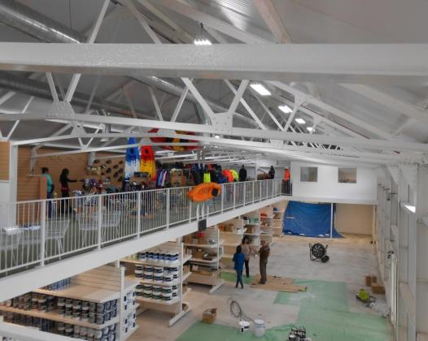
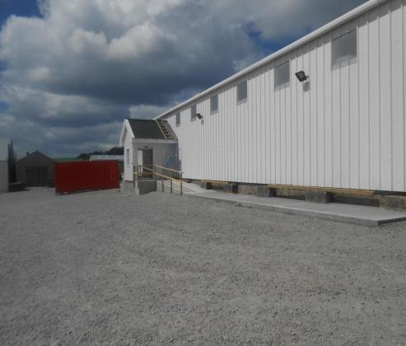
FIC : Expanding Home Builder DIY Store

Slide 10
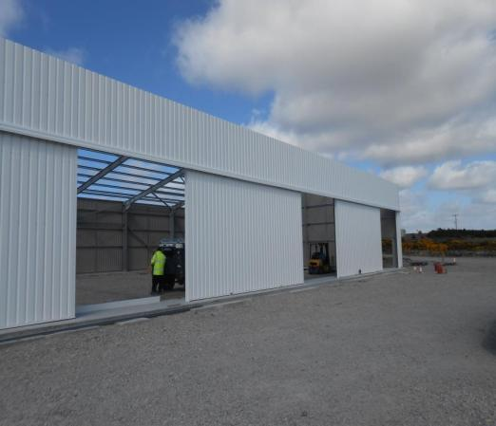
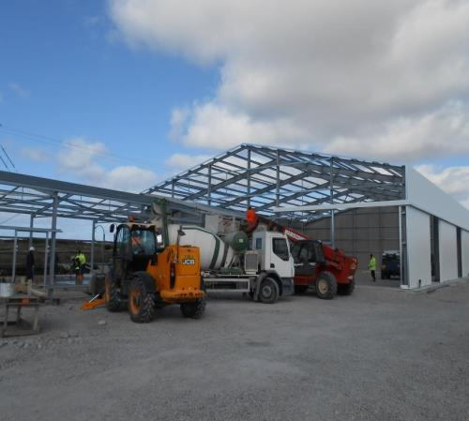
FIC : Investing in new warehousing

Slide 11
Falklands Oil Development Timeline : Revised View – November 2014

Slide 12
FIC Strategy Summary
FIC Summary
Falkland Islands economy buoyed by record squid catch and impending oil exploration in 2015
Premier Oil have scaled back Sea Lion – reduced capex required – more certain to progress :
  More affordable FPSO for phase 1 ( $2.0bn vs $5.2bn )
  Farm in partner no longer required – fundable by PMO and Rockhopper
  Project sanction expected H1 2016 ( post drilling )
  First Oil late 2019 – 2020
Significant upside potential from 2015 exploration drilling programme
Boost to short term trading in 2015 – more onshore activity than in 2012 drilling programme
Preparatory investment continuing to position existing FIC businesses and ready key sites for development
FIC in a unique position with its platform of service businesses and freehold land for development

Slide 13

Momart -Return to more normal trading patterns

Slide 14
Momart : 6 months ended 30 September 2014
Revenue and profits fell back to more normal levels - as expected
Revenue down 9.4% to £7.47million ( 2013: £8.24m )
PBTa lower at £0.41million (2013: £0.76m)
Absence of large overseas contracts saw Exhibitions revenue fall by 15.9% to £4.01million ( 2013: £4.77m)
Revenue from Gallery Services and Storage income flat on prior year
But plans for additional storage space being progressed in 2015 to address bottleneck
Final roll out new ERP system complete
Increased emphasis on sales and marketing – new web site, new Business Development Manager recruited.
Notable exhibitions H1 : Italian Fashion and Constable at the V&A : Anselm Keifer at the Royal Academy : Matisse Cut Outs & Kazimir Malevich at Tate Modern, The Viking World at the British Museum

Slide 15
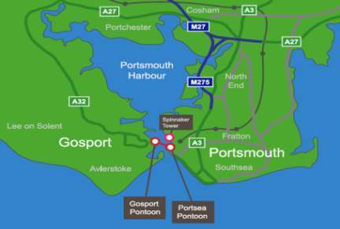
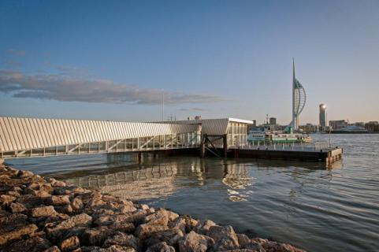
Portsmouth Harbour Ferry Company (PHFC)

Slide 16
P
PHFC : 6 months ended 30 September 2014
Ferry revenues ahead by 2.6% at £2.29million ( 2013: £2.24million)
Fare rises of 5-6% in June 2014
  Adult Return fares £3.10 (£2.90) , 10 Trip Ticket £14.50 ( £13.50)
  Child / OAP increased to £2.10 ( £1.90)
Passenger numbers fell by 2.0% vs H1 2013
  Q1 numbers showed welcome growth
  Q2 summer holiday traffic affected by heavily subsidised Park & Ride scheme in Portsmouth
PBTa ( after overhead allocation ) ahead by 12% at £0.35million in H1
New vessel Harbour Spirit almost complete – shipment to UK after sea trials in Jan 2015
10 year boat loan to be drawn down to finance 70% of £3.2m cost
New promotional fares and Solent e ticketing ( Oyster) set to underpin volumes
Positive medium term outlook for Portsmouth Naval Base

Slide 17
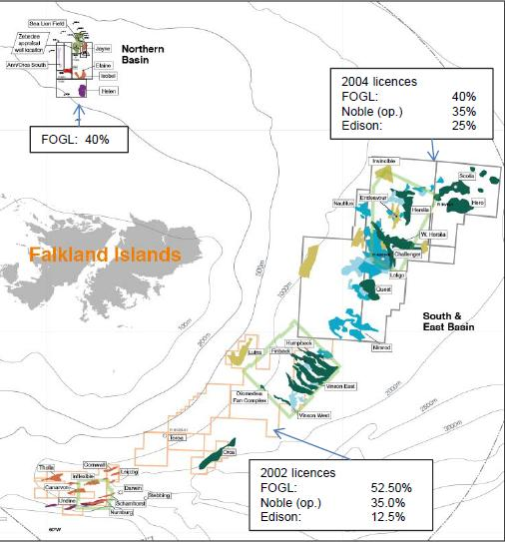
FOGL Licences: Location Map
FO

Slide 18
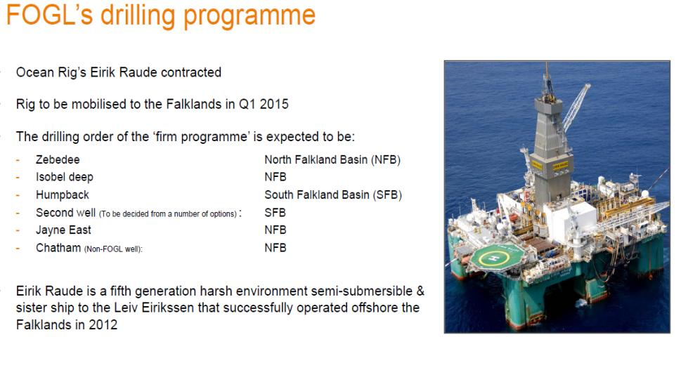
FOGL : 2015 Drilling programme
FO
Stebbing

Slide 19
Falkland Oil and Gas (FOGL)
FKL retains 12.8m FOGL shares (2.4%) – 1 FOGL share for each FKL share in issue
  Book cost 20p per share
  Partners : Noble Energy ( Mkt cap c $20bn) Edison International (Mkt cap EDF c $42bn )
FOGL has licences interests in North , East and South Basins including Sea Lion
3D seismic programme ( 12,000sq km ) has helped identify target prospects
6 well drilling programme due to start March 2015
  2 wells in the South and 4 in the North Falklands Basin
  High impact targets with > 1 bn bbls of gross prospects

Slide 20






FKL: Strategy
FKL: Strategy
  FIC : Leverage property assets and support services to maximise long term returns
  Momart : Expand storage capacity and develop sales & marketing to capitalise on brand reputation.
  PHFC : Modernise fleet and maintain steady growth in profits
  FOGL : Maintain shareholding through 2015 drilling campaign
  Group: Maintain/ grow dividend and maximise shareholder returns
20

Slide 21
FKL : Outlook
FIC
  Falklands economy set to remain buoyant in H2 .
  Retail , construction, property rental & automotive all set to benefit
  Improved outlook for cruise ship operators volumes recovering to pre recession levels
  Continuing investment in property assets in readiness for oil
PHFC
  BAE closure will be negative factor in short term
  Arrival of Harbour Spirit in Q1 2015 completes modernisation of ferry fleet
  Cyclical recovery & Dockyard expansion gives positive medium term view
Momart
  H2 order book healthy – benefits from new ERP system boosting efficiency
  Absence of high margin overseas contracts - drag on profits in H2
  Plans to expand storage business to remove block to further growth
Overall
  H1 trends set to continue in H2
  Spread of trading interests gives Group’s financial stability and protects dividend
  Growth in Falklands will help offset return to more normal trading at Momart

Slide 22
Appendices
Notes:
22

Slide 23
FKL : Cash flow 6 months ended 30 September 2014
All figs £’000’s | 2014 | 2013
Operating profit | 1,339 | 1,279
Depreciation | 592 | 630
Amortisation of Intangibles | 72 | 193
Provision for share based payments | 50 | 51
Loss on disposal of fixed assets | 143 | -
Less share of joint venture profit | (77) | -
Increase in working capital | (23) | (2,415)
Net Cash Flow from Operations | 2,096 | (262)
Net finance interest received | 4 | 59
Tax paid | (389) | (305)
Dividends paid | (929) | (928)
Capital expenditure | (1,860) | (1,058)
Cash inflows on loan with joint venture | 151 | -
Other | 2 | (54)
Net Cash Flow | (925) | (2,548)
Decrease in Bank Borrowings and HP | 693 | 697
Decrease in Cash | (1,618) | (3,245)
Reduction in Cash net of Bank Borrowings & HP | (925) | (2,548)

Slide 24
FKL : Balance Sheet
All figs £’000’s | 30 Sept 2014 |  | 31 March 2014 |  | 30 Sept 2013
Tangible Fixed Assets | 17,759 |  | 16,609 |  | 13,962
Investment properties at net book value | 3,366 |  | 3,396 |  | 2,960
Goodwill & Intangibles | 12,243 |  | 12,238 |  | 12,122
Quoted investments at market value | 3,623 |  | 3,270 |  | 3,623
Deferred Tax & other assets | 1,582 |  | 1,602 |  | 955
Total non current assets | 38,573 |  | 37,115 |  | 33,622
Working Capital - Net | 3,302 |  | 3,255 |  | 4,025
Cash | 4,097 |  | 5,715 |  | 8,171
Corporation tax payable | (327) |  | (419) |  | (382)
Bank Loans etc due within 1 year | (679) |  | (1,109) |  | (1,121)
Net Current Assets | 6,393 |  | 7,442 |  | 10,693
Bank Loans etc due after 1 year | (218) |  | (203) |  | (745)
Finance Lease re Pontoon due after 1yr | (4,843) |  | (4,858) |  | (4,873)
Pension Provisions & Def. Tax | (4,119) |  | (4,119) |  | (4,278)
Equity Shareholders funds | 35,786 |  | 35,377 |  | 34,419
Net Assets per share | £2.88 |  | £2.85 |  | £2.77

Slide 25
FKL: Net borrowings and liquidity
 | 30 Sept 2014 £000 | 31 March 2014 £000 | 30 Sept 2013 £000
Bank Loans & HP due within 1 year | (650) | (1,081) | (1,093)
Bank loans & HP due after 1 year | (218) | (203) | (745)
Total Bank Borrowings & HP | (868) | (1,284) | (1,838)
Cash | 4,097 | 5,715 | 8,171
Total net cash / (debt) excl long term Pontoon lease | 3,229 | 4,431 | 6,333
Long term finance lease re Pontoon | (4,872) | (4,886) | (4,901)
Total Net Cash /(Borrowings) | (1,643) | (455) | 1,432
Net Tangible Assets | 23,575 | 23,139 | 22,297

Slide 26
FIC: Sites for development
FIC: Sites for development
 | Site | Location & size | Development Potential
1 | Fitzroy Road | 2 acres , Central Stanley | 26 x 2 bed apartments.
2 | Dairy Paddock | Western Stanley 36 acres | Planning for 350 houses / Work camp
3 | YPF site | Central Stanley, 2.25 acres | Offices , high quality residential
4 | East Jetty | Waterfront Stanley , 3.0 acres | FIC warehousing – prime site for re-development
5 | “Coastel” Road | FIPASS area, 7.5 acres | Warehousing & lay down areas with planning
6 | Airport Road/FIPASS | FIPASS ,11.0 acres | Warehousing & lay down areas with planning
7 | Fairy Cove | North side of Stanley Harbour, 301 acres | Adjoins site for proposed new deep water port at Navy Point

Slide 27
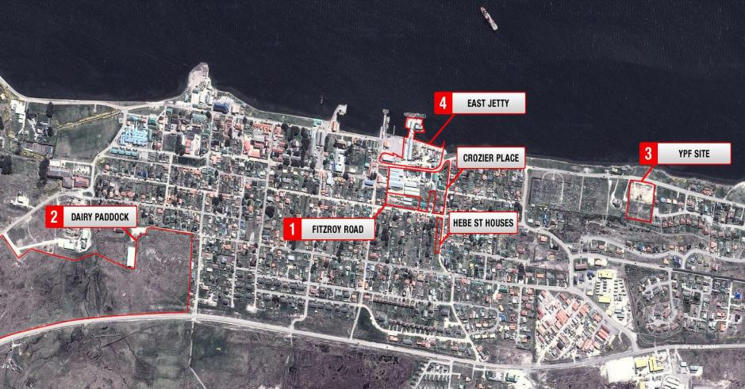
Map of FIC Development Sites
Map of FIC Development Sites

Slide 28
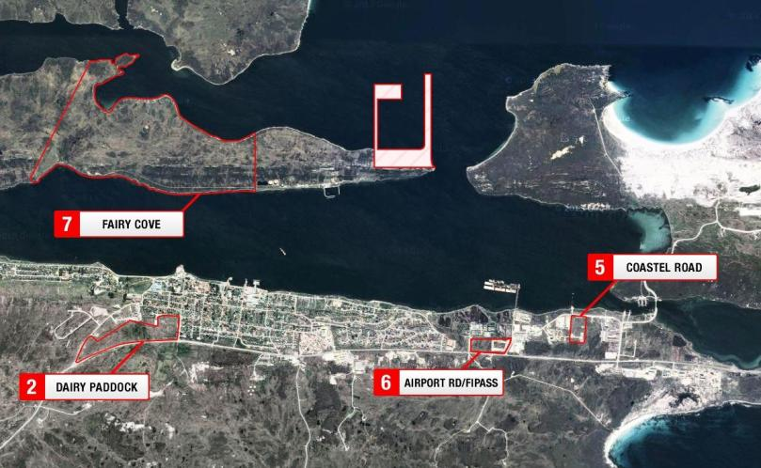
Map of FIC Development Sites
Map of FIC Development Sites

Slide 29
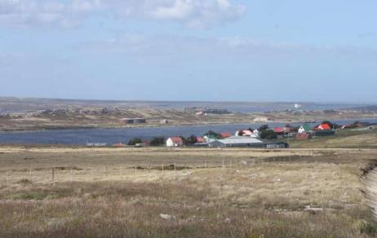
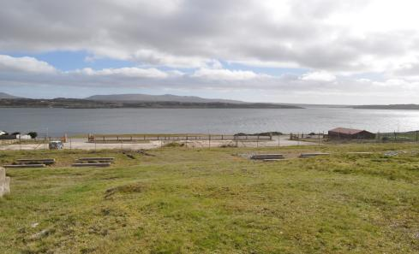
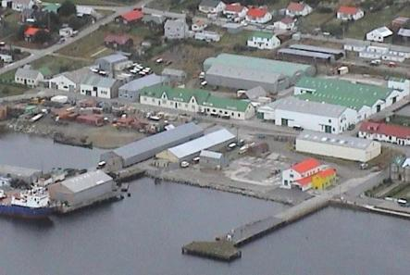
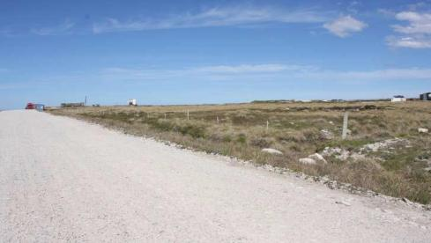
FIC: Development sites in Stanley
FIC: Development sites in Stanley
Dairy Paddock 36 acre site in central Stanley
YPF site on Stanley Harbour 2.25 acres
Fairy Cove : 300 acre site next to Navy Point harbour site
Planning permission for workers camp and 350 houses
Prestige site for high quality residential homes
Prime central site for offices , hotel / leisure
Site 2
Site 3
Crozier Place and East Jetty, 3.0 acres
Coastel Rd site on Stanley Harbour 7.5 acres
Warehousing, lay down areas and storage
Prime central site for Offices, Hotel or Leisure.
Site 5
Site 4
Notes:
29

Slide 30
FKL – 9 Year Track Record
30

Slide 31


Notes:
31

